Slide 1

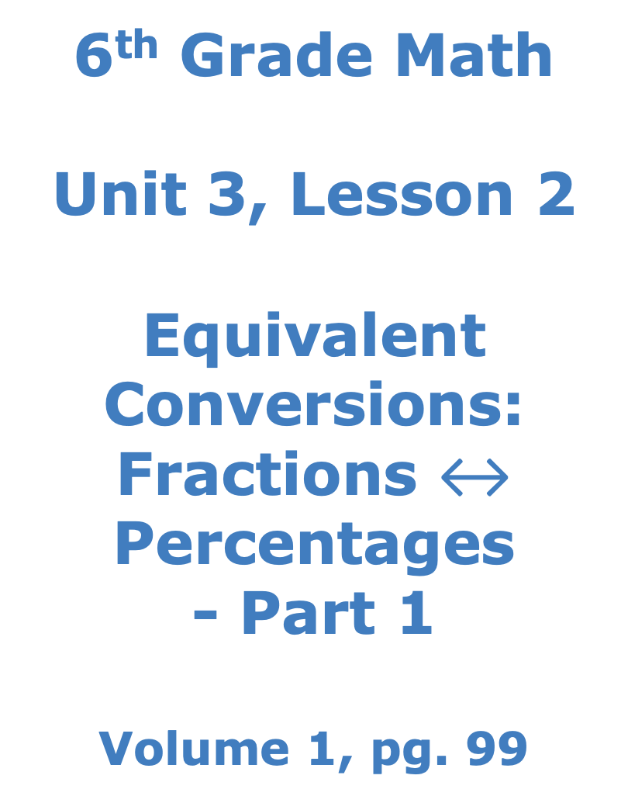
6th Grade Math
Unit 3, Lesson 2 Equivalent Conversions: Fractions $↔$ Percentages - Part 1 Volume 1, pg. 99

Slide 2


Benchmark
MA.6.NSO.3.5
Rewrite positive rational numbers in different but equivalent forms including fractions, terminating decimals, and percentages.
volume 1, pg. 99

Slide 3
Integrated Mathematical Thinking and Reasoning Standards
MA.K12.MTR.2.1 Demonstrate understanding by representing problems in multiple ways.
MA.K12.MTR.3.1 Complete tasks with mathematical fluency.
volume 1, pg. 99

Slide 4

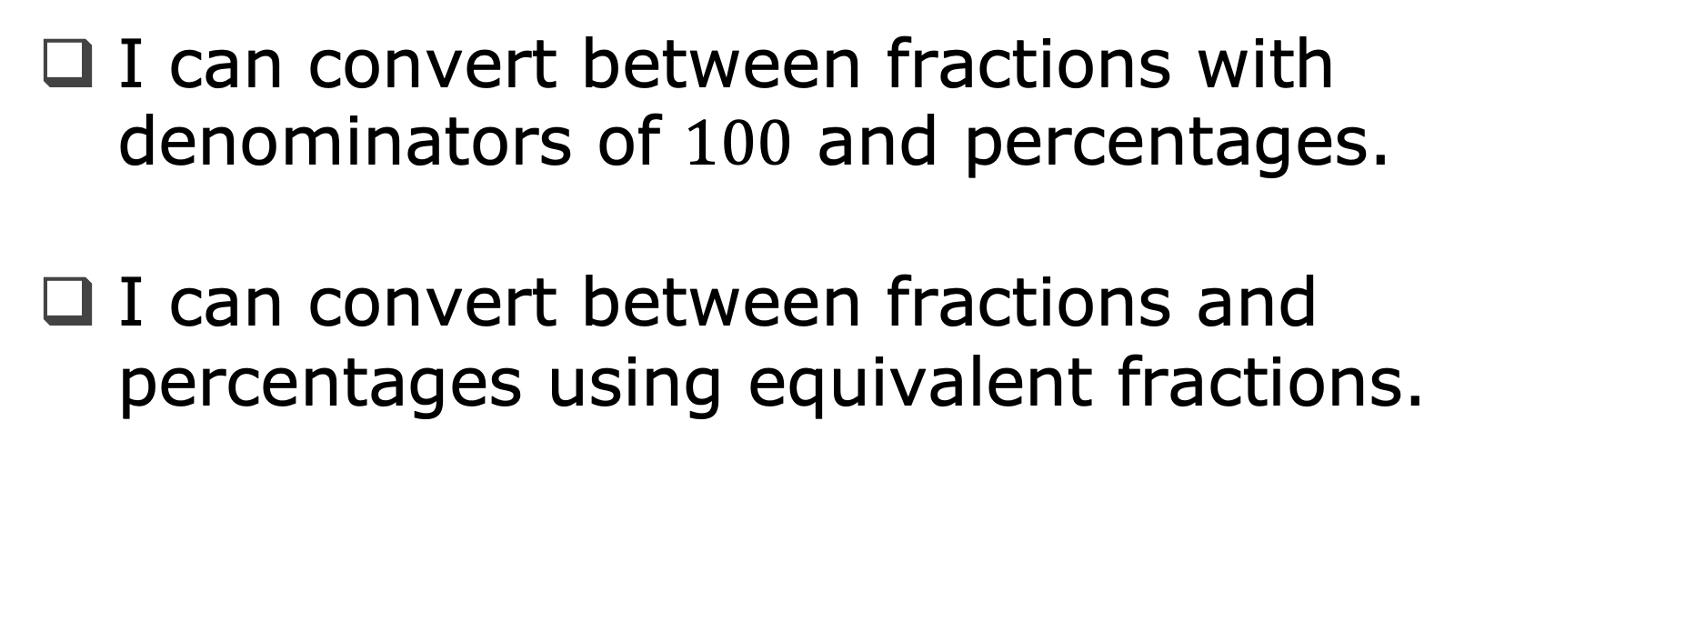
Learning Targets
I can convert between fractions with denominators of $100$ and percentages.
I can convert between fractions and percentages using equivalent fractions.
volume 1, pg. 99

Slide 5

Warm-Up
volume 1, pg. 99

Slide 6
3.2.1 Warm-Up: A Brief History of Numerical Systems
Humans went from using body parts, tally marks, and symbols to count objects, to what we now know as the base-ten system. Multiple civilizations around the world developed positional numbering systems, and both Mayan and Indian civilizations developed the concept of “zero.” The base-ten system was perfected by eighth century Indian mathematicians. They realized that they could combine the concept of “zero” with a positional system that used repeatable symbols, whose values are determined by their position in a sequence. A base of ten was selected because, quite simply, we have ten fingers. Centuries later, this Hindu-Arabic numeral system began to spread to Europe and replaced the Roman numeral system. This is what we use today.
What is the historical importance of the number zero?
If zero was never created, how would that affect how we do math today?
volume 1, pg. 99

Slide 7

Guided Instruction
volume 1, pg. 100

Slide 8
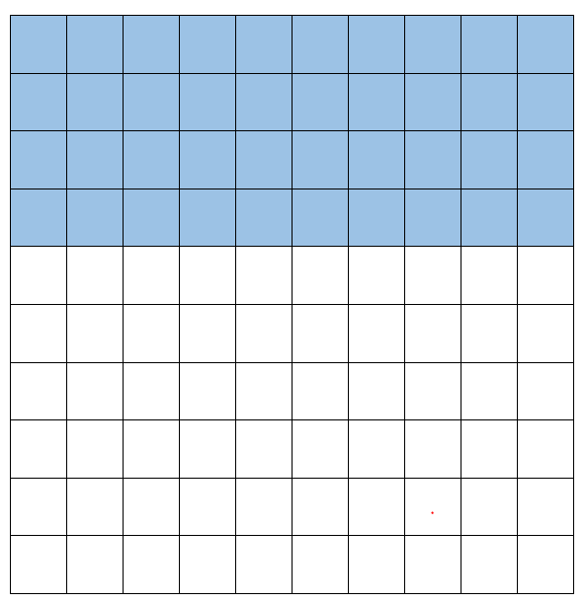
3.2.2 Guided Instruction: Converting Between Fractions and Percentages
The model represents a numerical value. Use the model to answer the questions that follow.
How many total squares are in the image?
How many of the squares are shaded blue?
volume 1, pg. 100

Slide 9
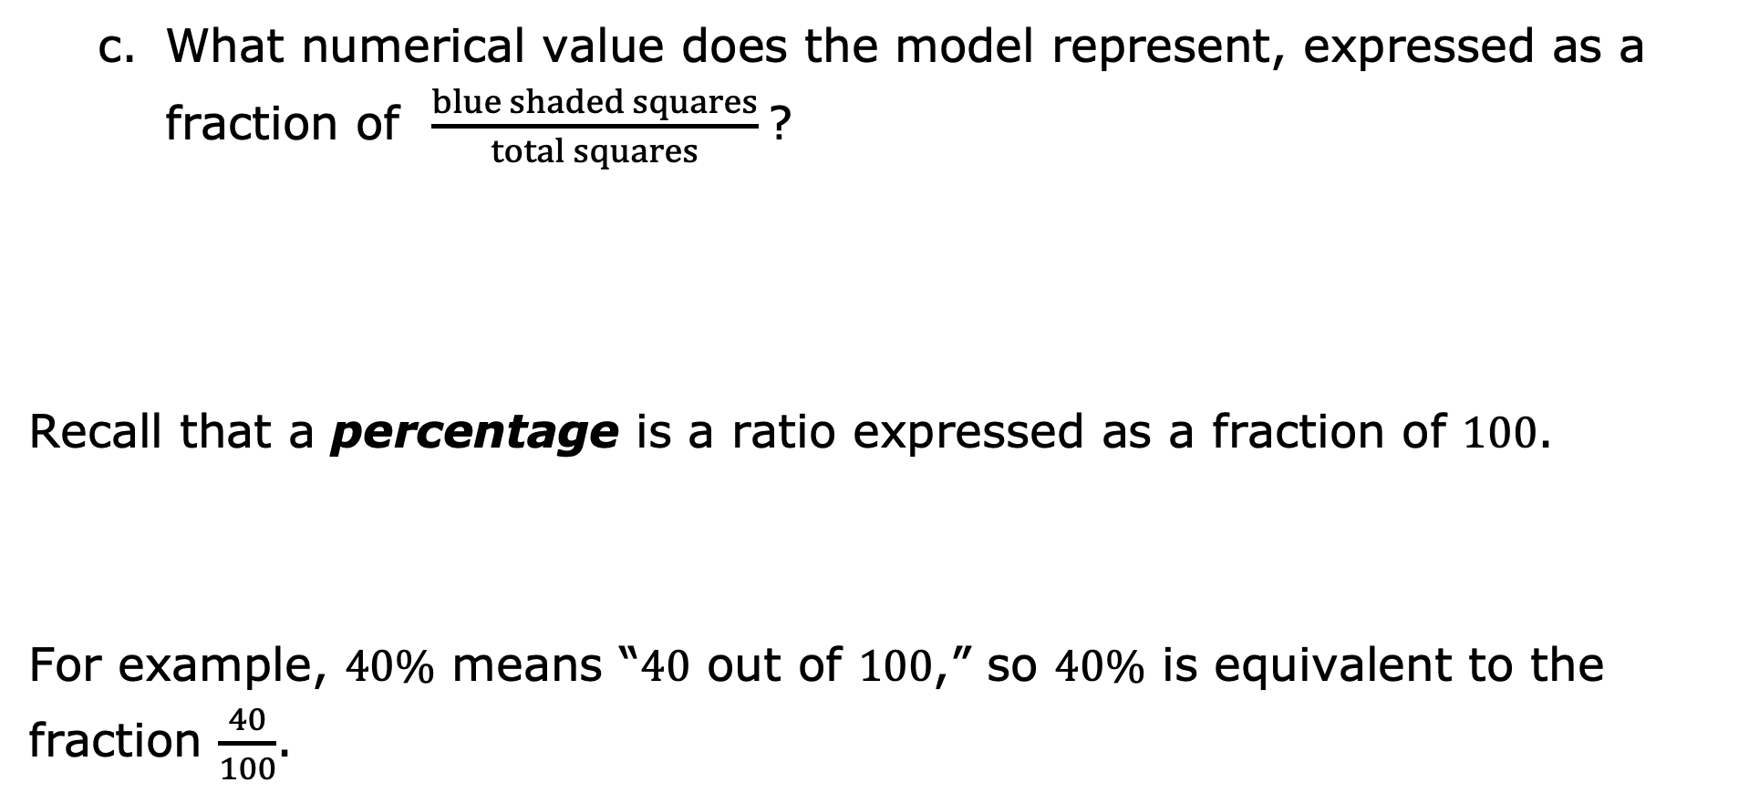
What numerical value does the model represent, expressed as a fraction of $\frac{blue shaded squares}{total squares}$?
Recall that a percentage is a ratio expressed as a fraction of $100$.
For example, $40\%$ means “$40$ out of $100$,” so $40\%$ is equivalent to the fraction $\frac{40}{100}$.
Percent ($\%$) means “per $100$,” “for every $100$,” or “out of $100$.”
volume 1, pg. 100

Slide 10
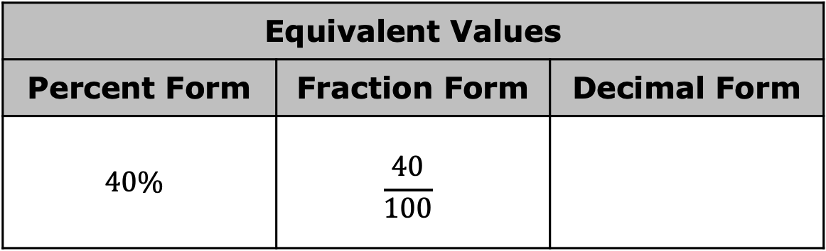
What decimal value has the same value as $40\%$ and $\frac{40}{100}$?
Equivalent Values
Percent Form | Fraction Form | Decimal Form
$$40\%$$ | $$\frac{40}{100}$$
volume 1, pg. 100

Slide 11
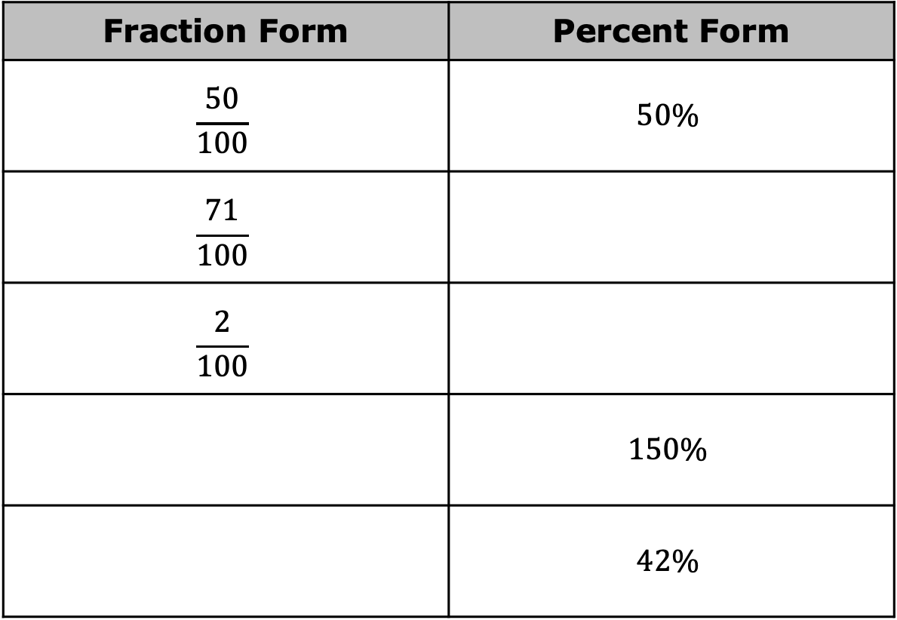
With your partner, complete the table by rewriting each value in the equivalent form indicated.
Fraction Form | Percent Form
$$\frac{50}{100}$$ | $$50\%$$
$$\frac{71}{100}$$
$$\frac{2}{100}$$
 | $$150\%$$
 | $$42\%$$
volume 1, pg. 100

Slide 12
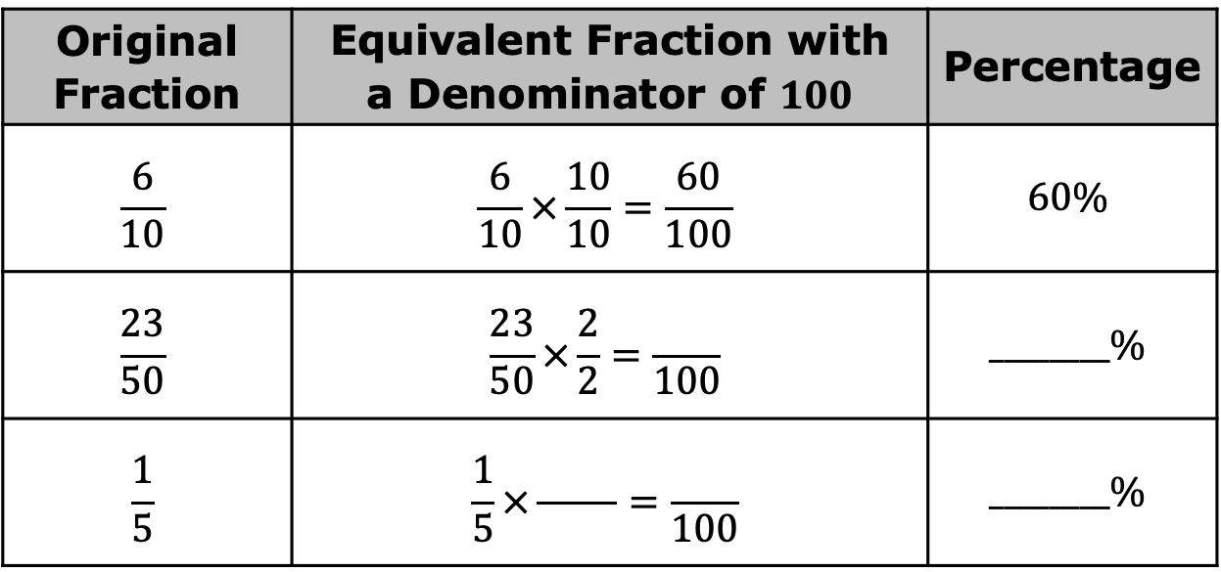
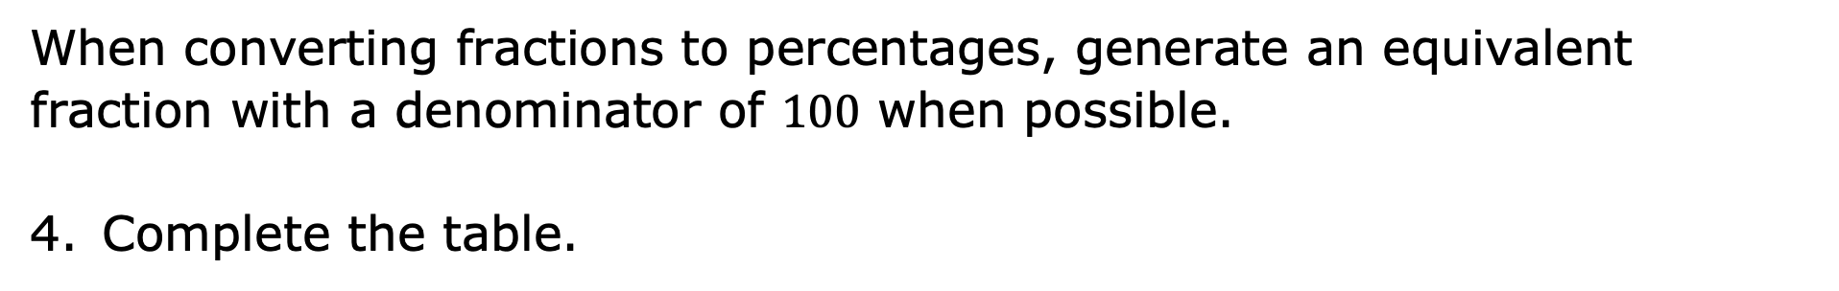
When converting fractions to percentages, generate an equivalent fraction with a denominator of $100$ when possible.
Complete the table.
Original Fraction | Equivalent Fraction with a Denominator of $100$ | Percentage
$$\frac{6}{10}$$ | $$\frac{6}{10}×\frac{10}{10}=\frac{60}{100}$$ | $$60\%$$
$$\frac{23}{50}$$ | $$\frac{23}{50}×\frac{2}{2}=\frac{ }{100}$$ | $$________\%$$
$$\frac{1}{5}$$ | $$\frac{1}{5}×\frac{ }{ }=\frac{ }{100}$$ | $$________\%$$
volume 1, pg. 101

Slide 13

Guided Practice
volume 1, pg. 101

Slide 14

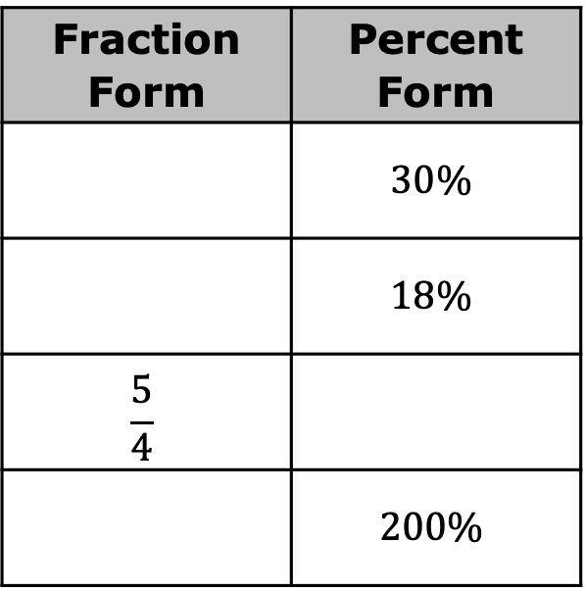
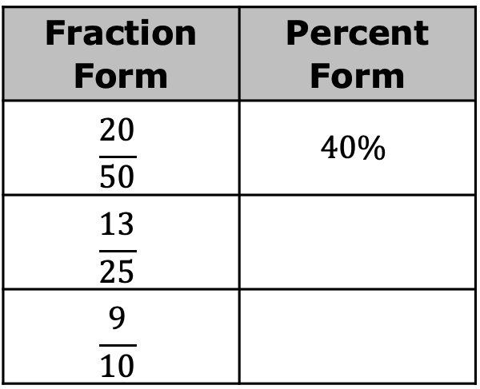
3.2.3 Guided Practice: Converting Between Fractions and Percentages
Complete the table by rewriting each value in the equivalent form indicated. Simplify where applicable.
Fraction Form | Percent Form
$$\frac{20}{50}$$ | $$40\%$$
$$\frac{13}{25}$$
$$\frac{9}{10}$$
Fraction Form | Percent Form
 | $$30\%$$
 | $$18\%$$
$$\frac{5}{4}$$
 | $$200\%$$
volume 1, pg. 101

Slide 15

Your Turn
volume 1, pg. 102

Slide 16
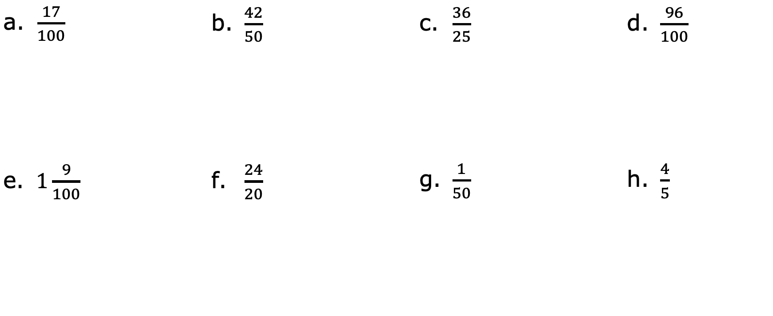
3.2.4 Your Turn!
Rewrite each fraction as an equivalent percentage.
$\frac{17}{100}$ | b. $\frac{42}{50}$ | c. $\frac{36}{25}$ | d. $\frac{96}{100}$
e. $1\frac{9}{100}$ | f. $\frac{24}{20}$ | g. $\frac{1}{50}$ | h. $\frac{4}{5}$
volume 1, pg. 102

Slide 17
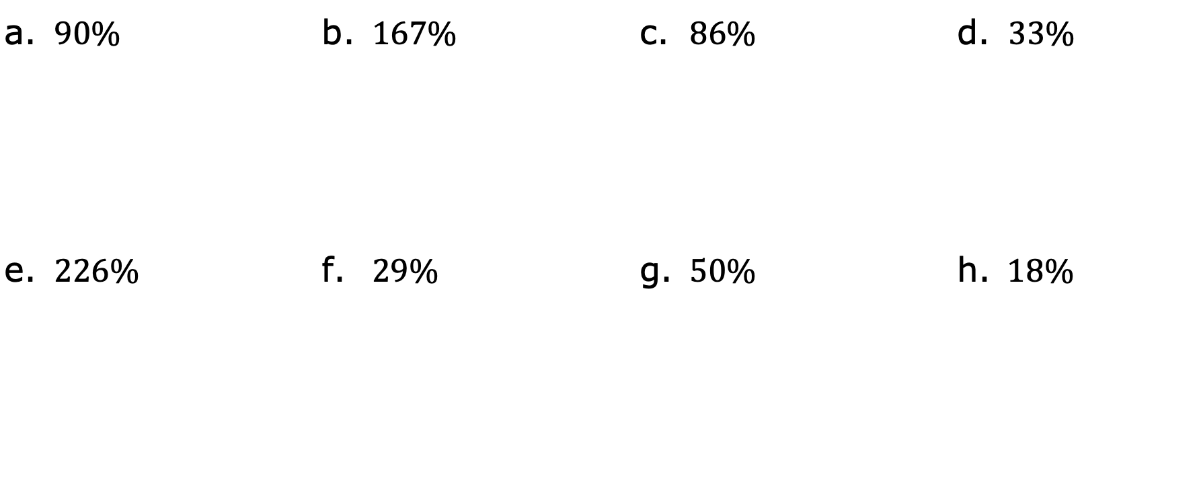
Convert each to a fraction. Simplify where applicable.
a. $90\%$ | b. $167\%$ | c. $86\%$ | d. $33\%$
e. $226\%$ | f. $29\%$ | g. $50\%$ | h. $18\%$
volume 1, pg. 102

Slide 18

Wrap-Up
volume 1, pg. 103

Slide 19
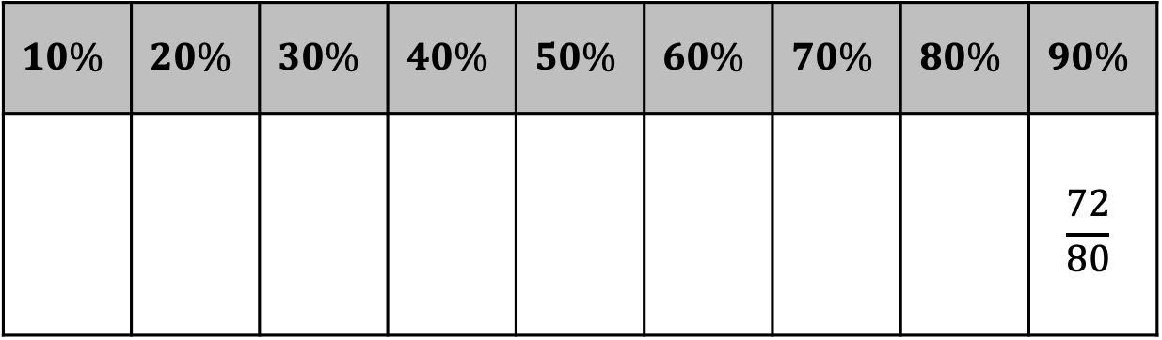
3.2.5 Wrap-Up: Ticket Out the Door
Use the numbers below to create three more fractions equivalent to any three percentages in the table.
15 | 4 | 21 | 30 | 25 | 40
32 | 1 | 8 | 2 | 6 | 10
7 | 50 | 72 | 5 | 80 | 3
$$10\%$$ | $$20\%$$ | $$30\%$$ | $$40\%$$ | $$50\%$$ | $$60\%$$ | $$70\%$$ | $$80\%$$ | $$90\%$$
 |  |  |  |  |  |  |  | $$\frac{72}{80}$$
volume 1, pg. 103

